Slide 1
Chapter 4 – Paths in Graphs
Parth Nagarkar
* Content borrowed from: S. Dasgupta, C. H. Papadimitriou, and U. V. Vazirani. Algorithms

Slide 2
Distances
DFS readily identifies all the vertices of a graph that can be reached from a designated starting point
It also finds explicit paths to these vertices

Slide 3
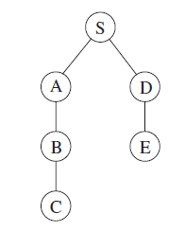
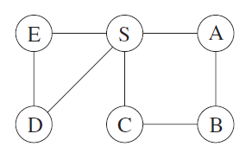
Distances
However these paths might not be the most economical ones possible
A sample graph
Its DFS Tree

Slide 4
Distances
Vertex C is reachable from S by traversing just one edge, while the DFS Tree shows a path of length 3
A sample graph
Its DFS Tree

Slide 5
Shortest Paths
Path lengths allow us to talk quantitatively about the extent to which different vertices of a graph are separated from each other
A sample graph
Its DFS Tree
Notes:
This chapter is about algorithms for finding shortest paths in graphs

Slide 6
Shortest Paths
The distance between two nodes is the length of the shortest path between them
A sample graph
Its DFS Tree
Notes:
For example, vertex B is at distance 2 from S, and there are two shortest paths to it.

Slide 7
Breadth-First Search (BFS)
BFS searches the graph by proceeding layer by layer
BFS finds all nodes that are at distance = 1 from the starting node
These are added to a queue
Then for each node that is processed (i.e. ejected off from the front of the queue), their as-yet-unseen neighbors are injected into the end of the queue

Slide 8
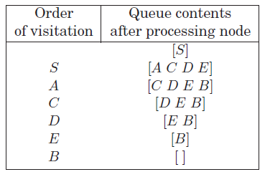
Breadth-First Search (BFS)

Slide 9
Breadth-First Search (BFS)

Slide 10
Breadth-First Search (BFS)

Slide 11
Breadth-First Search (BFS)

Slide 12
Breadth-First Search (BFS)

Slide 13
Breadth-First Search (BFS)

Slide 14
Breadth-First Search (BFS)

Slide 15
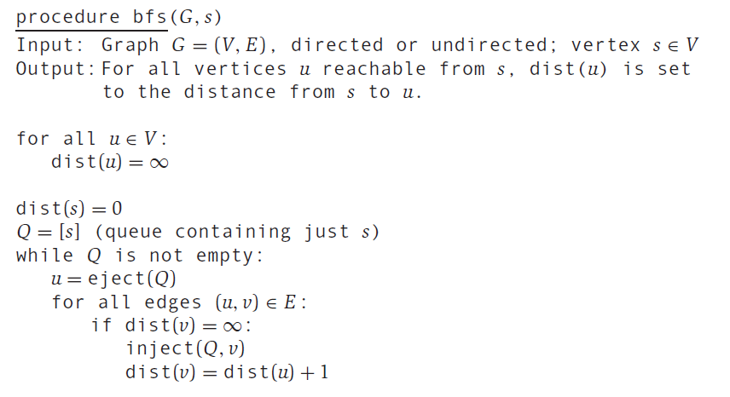
Breadth-First Search (BFS)

Slide 16
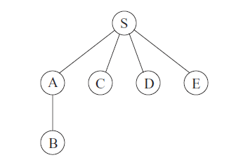
Breadth-First Search (BFS)
Its BFS Tree

Slide 17
BFS Tree
BFS Tree contains the edges through which each node is initially discovered
Unlike DFS Tree, in BFS Tree, all paths from S are the shortest possible

Slide 18
BFS Tree
Hence it is a shortest-path tree
Unlike DFS Tree, in BFS Tree, all paths from S are the shortest possible

Slide 19
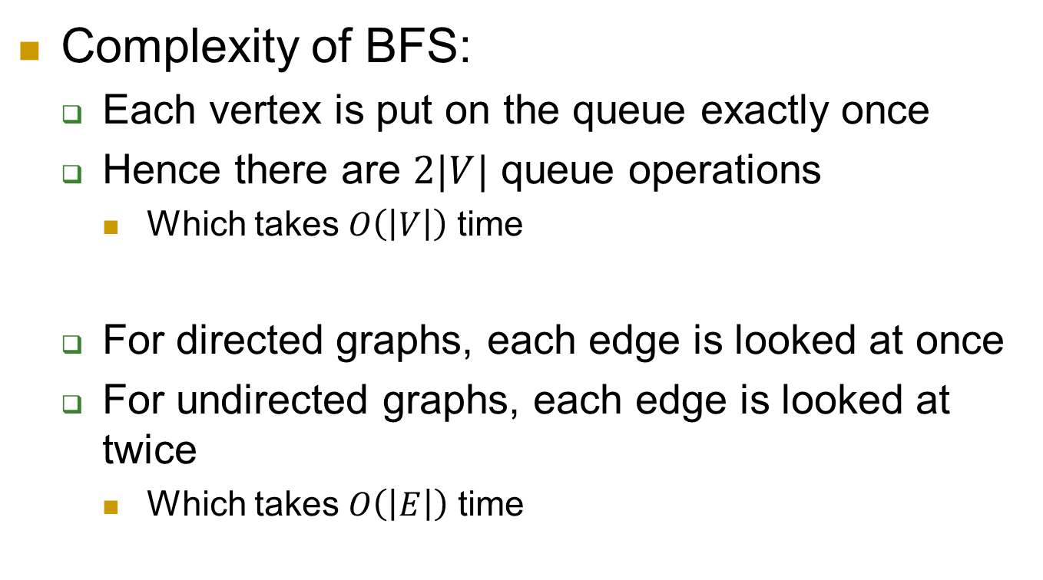
Breadth-First Search (BFS)
Complexity of BFS:
Each vertex is put on the queue exactly once
Hence there are $2|V|$ queue operations
Which takes $O\left(\left|V\right|\right)$ time
For directed graphs, each edge is looked at once
For undirected graphs, each edge is looked at twice
Which takes $O\left(\left|E\right|\right)$ time
Notes:
queue + dequeue operations

Slide 20
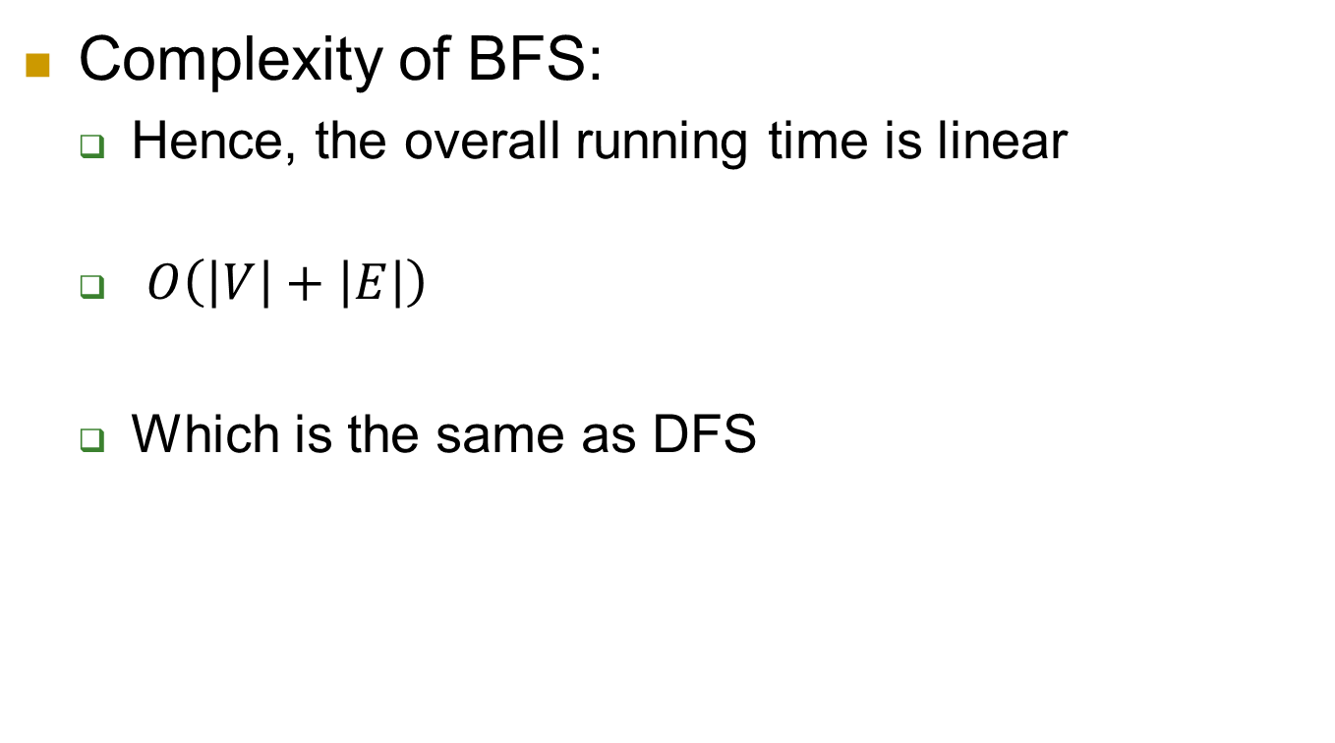
Breadth-First Search (BFS)
Complexity of BFS:
Hence, the overall running time is linear
$O\left(\left|V\right|+\left|E\right|\right)$
Which is the same as DFS
Notes:
queue + dequeue operations

Slide 21
BFS vs DFS
DFS makes deep incursions into a graph
It retreats only when it runs out of new nodes to visit
What are the benefits?

Slide 22
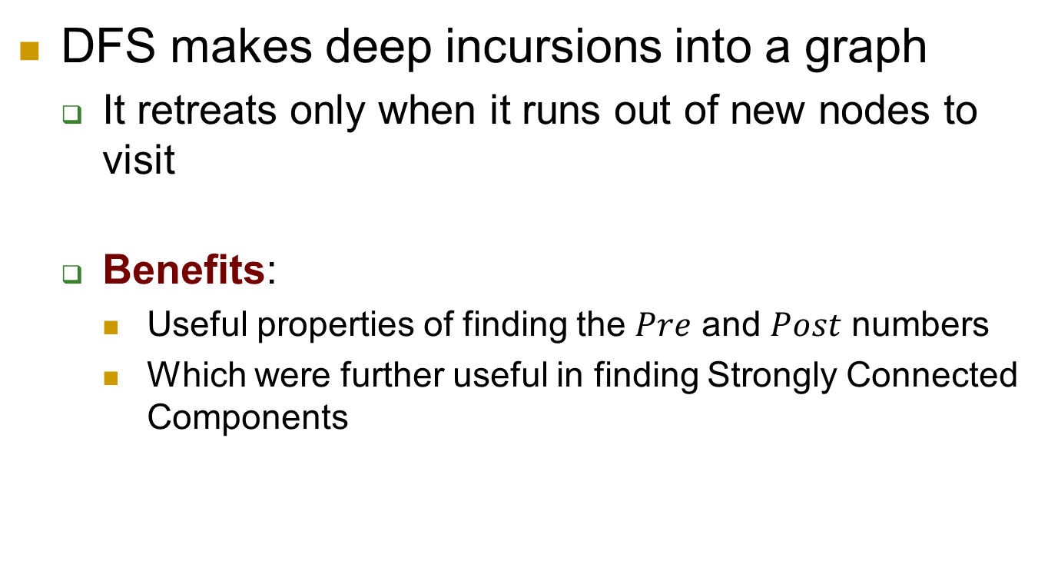
BFS vs DFS
DFS makes deep incursions into a graph
It retreats only when it runs out of new nodes to visit
Benefits:
Useful properties of finding the $Pre$ and $Post$ numbers
Which were further useful in finding Strongly Connected Components

Slide 23
BFS vs DFS
DFS makes deep incursions into a graph
It retreats only when it runs out of new nodes to visit
What are the disadvantages?

Slide 24
BFS vs DFS
DFS makes deep incursions into a graph
It retreats only when it runs out of new nodes to visit
Disadvantages:
DFS can take a long and convoluted route to a vertex that is actually very close by

Slide 25
BFS vs DFS
BFS makes sure to visit vertices in increasing order of their distance from the starting point
It is a broader, shallower search, rather like the propagation of a wave upon water
Achieved using almost exactly the same code as DFS
Uses a queue instead of a stack!

Slide 26
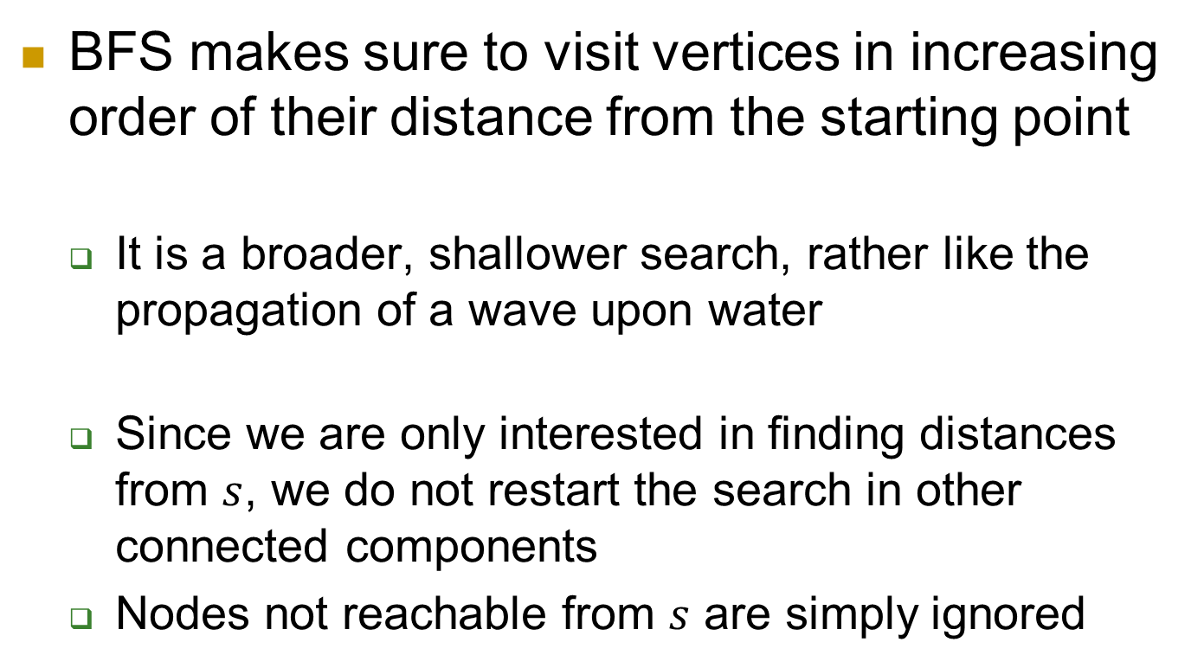
BFS vs DFS
BFS makes sure to visit vertices in increasing order of their distance from the starting point
It is a broader, shallower search, rather like the propagation of a wave upon water
Since we are only interested in finding distances from $s$, we do not restart the search in other connected components
Nodes not reachable from $s$ are simply ignored

Slide 27
Lengths on Edges
BFS treats all edges as having the same length
Rarely true in applications where shortest paths are to be found
Suppose you are driving from San Francisco to Las Vegas, and want to find the quickest route

Slide 28
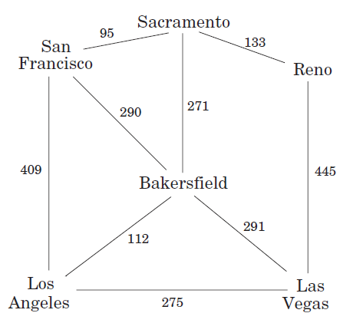
Lengths on Edges
Suppose you are driving from San Francisco to Las Vegas, and want to find the quickest route
Picking the right combination of major highways is a shortest-path problem

Slide 29
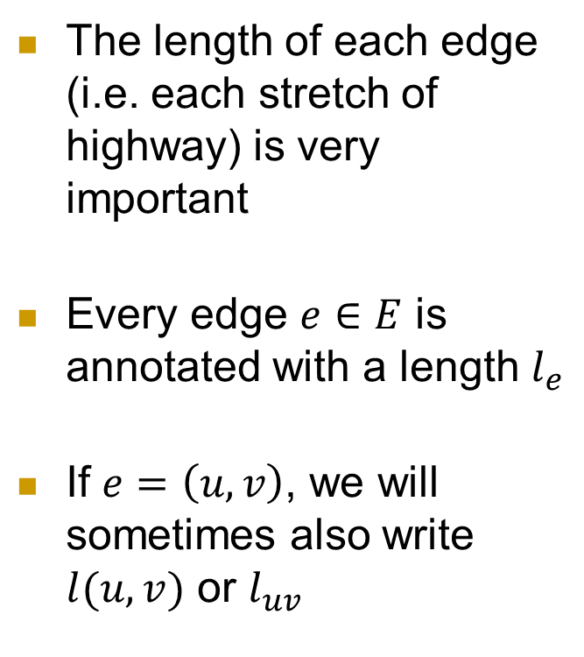
Lengths on Edges
The length of each edge (i.e. each stretch of highway) is very important
Every edge $e∈E$ is annotated with a length $l_{e}$
If $e=\left(u,v\right)$, we will sometimes also write $l(u,v)$ or $l_{uv}$

Slide 30
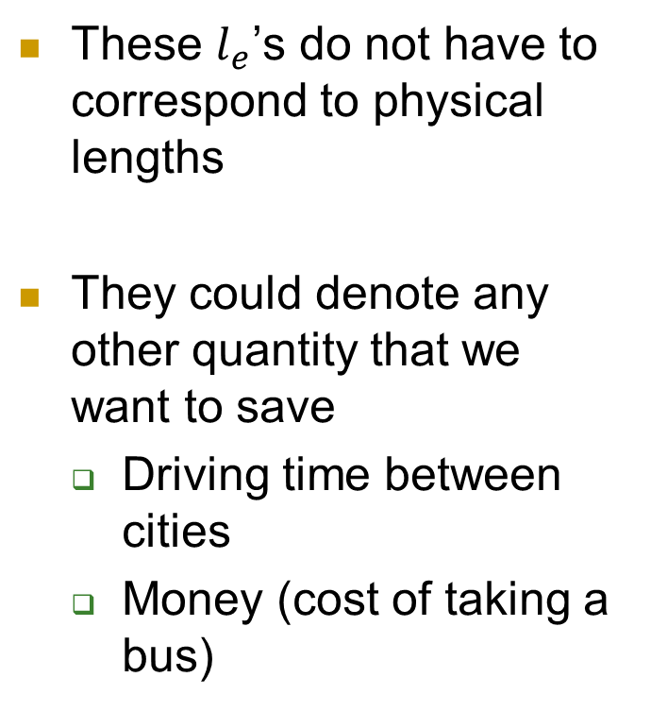
Lengths on Edges
These $l_{e}$’s do not have to correspond to physical lengths
They could denote any other quantity that we want to save
Driving time between cities
Money (cost of taking a bus)

Slide 31
Drawbacks of BFS in shortest paths
BFS finds shortest paths in any graph whose edges have unit length
But what happens when you have edge length with different positive integers?

Slide 32
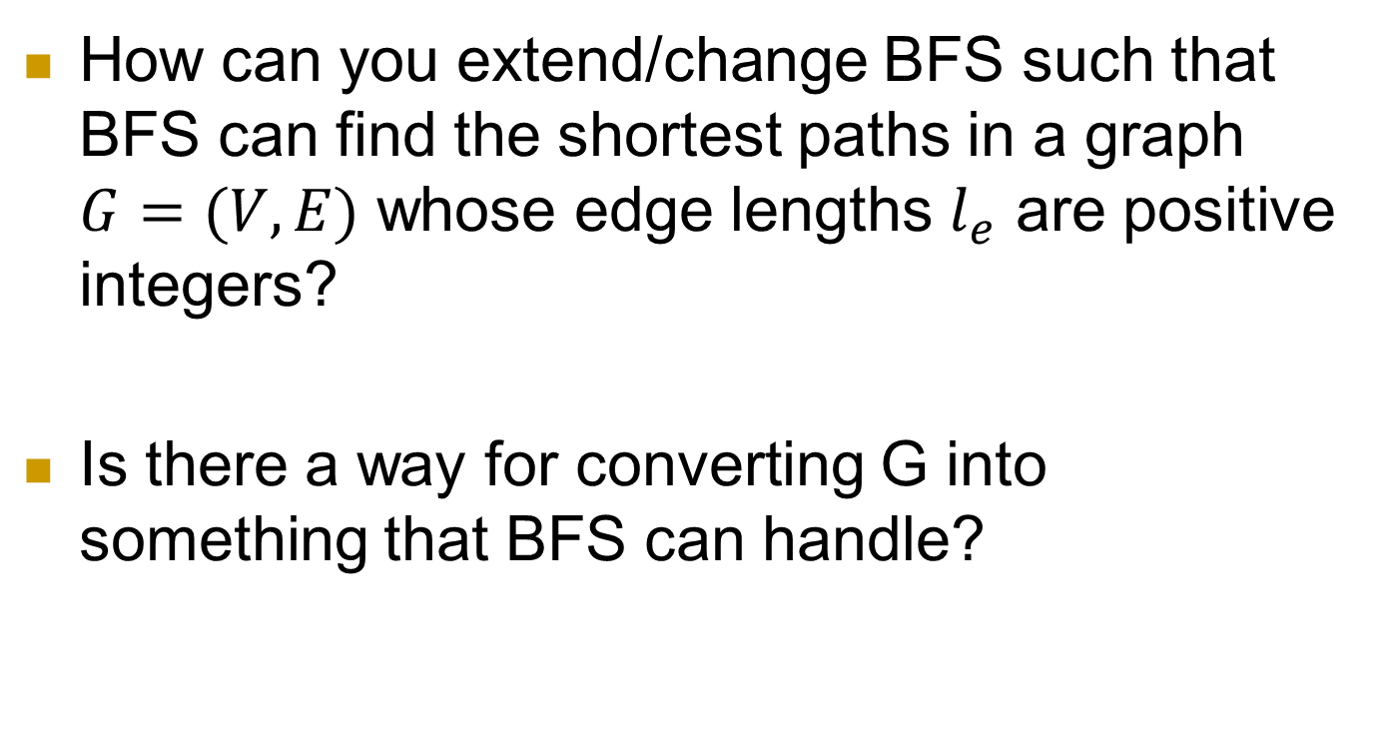
Drawbacks of BFS in shortest paths
How can you extend/change BFS such that BFS can find the shortest paths in a graph $G=(V,E)$ whose edge lengths $l_{e}$ are positive integers?
Is there a way for converting G into something that BFS can handle?

Slide 33
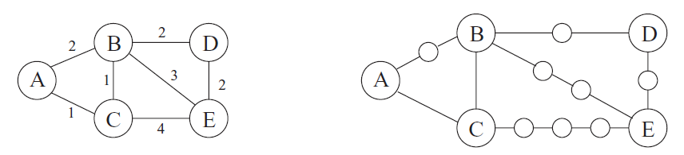

An Adaptation of BFS
Break $G$’s long edges into unit-length pieces by introducing “dummy” nodes

Slide 34
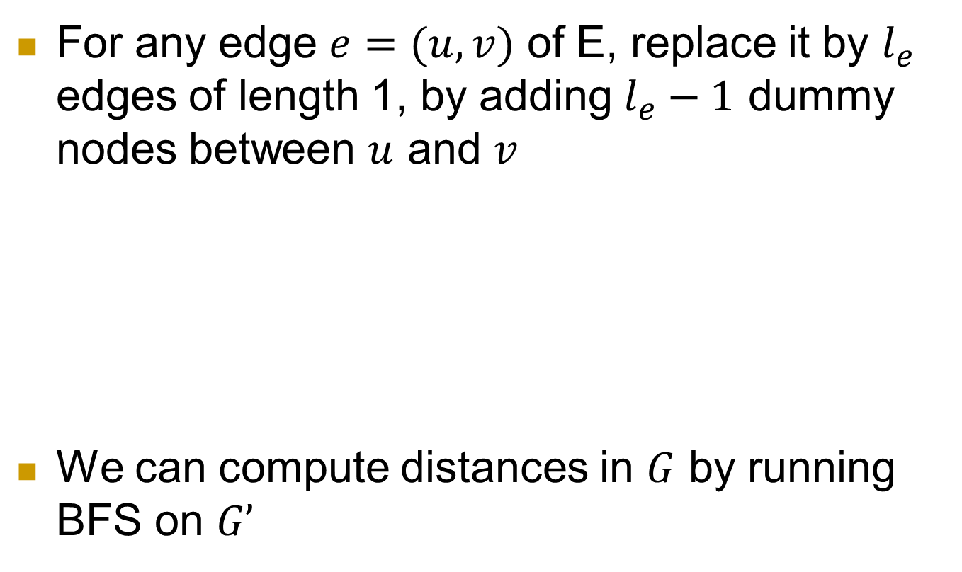
An Adaptation of BFS
For any edge $e=(u,v)$ of E, replace it by $l_{e}$ edges of length 1, by adding $l_{e}−1$ dummy nodes between $u$ and $v$
We can compute distances in $G$ by running BFS on $G’$

Slide 35
An Adaptation of BFS
What’s the drawback of this approach?
What happens if you have edge lengths in 100s?
The algorithm becomes very slow!

Slide 36
Dijkstra’s Algorithm
Algorithm for finding the shortest paths between nodes in a graph
Also called Shortest Path First algorithm
Original algorithm found the shortest path between two given nodes,
A more common variant finds shortest paths from the source to all other nodes in the graph
Producing a shortest-path tree
Notes:
It was conceived by computer scientist Edsger W. Dijkstra in 1956 and published three years later.

Slide 37
Dijkstra’s Algorithm
The algorithm can be considered as BFS while using a priority queue (instead of a regular queue)
In a priority queue, each item is associated with a priority value
Items are ordered by their priority so that the item with the highest priority is at the front of the queue
Notes:
https://www.tutorialspoint.com/data_structures_algorithms/priority_queue.htm

Slide 38
Dijkstra’s Algorithm
There are several implementations of Dijkstra’s algorithm
We will be focusing on the priority queue implementation
The complexity of the algorithm also depends on the chosen implementation
Notes:
https://www.tutorialspoint.com/data_structures_algorithms/priority_queue.htm

Slide 39
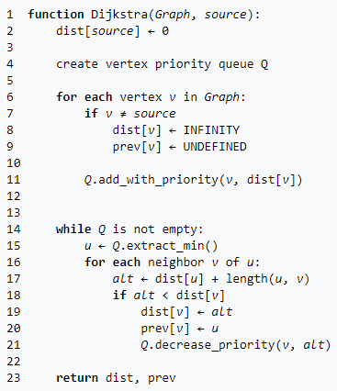
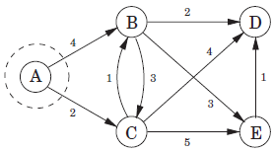
Dijkstra’s Algorithm
Notes:
Pseudocode copied from https://en.wikipedia.org/wiki/Dijkstra%27s_algorithm

Slide 40

Dijkstra’s Algorithm
Notes:
Pseudocode copied from https://en.wikipedia.org/wiki/Dijkstra%27s_algorithm

Slide 41

Dijkstra’s Algorithm
Notes:
Pseudocode copied from https://en.wikipedia.org/wiki/Dijkstra%27s_algorithm

Slide 42

Dijkstra’s Algorithm
Notes:
Pseudocode copied from https://en.wikipedia.org/wiki/Dijkstra%27s_algorithm

Slide 43
Dijkstra’s Algorithm
Notes:
Pseudocode copied from https://en.wikipedia.org/wiki/Dijkstra%27s_algorithm

Slide 44
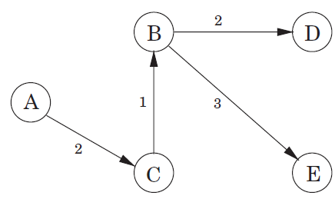
Dijkstra’s Algorithm
Shortest Path Tree
Notes:
Pseudocode copied from https://en.wikipedia.org/wiki/Dijkstra%27s_algorithm

Slide 45
Dijkstra’s Algorithm Complexity
Depends on the underlying data structure used
Which are the expensive operations in this code?
Extract_min
Add_with_priority + Decrease_priority
Notes:
Pseudocode copied from https://en.wikipedia.org/wiki/Dijkstra%27s_algorithm

Slide 46
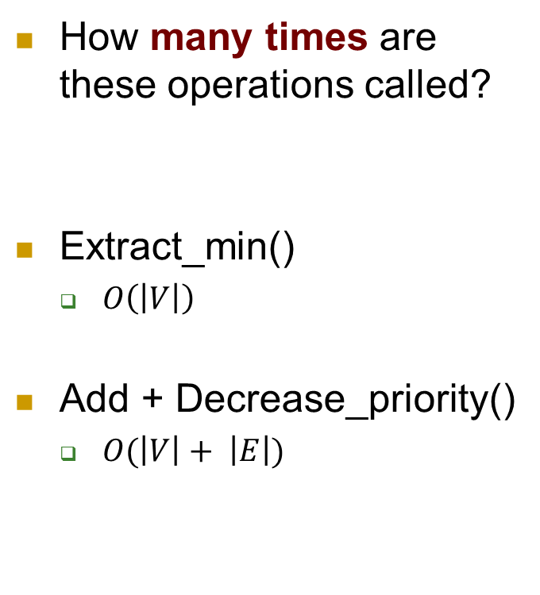
Dijkstra’s Algorithm Complexity
How many times are these operations called?
Extract_min()
$O\left(\left|V\right|\right)$
Add + Decrease_priority()
$O(\left|V\right|+ \left|E\right|)$
Notes:
Pseudocode copied from https://en.wikipedia.org/wiki/Dijkstra%27s_algorithm

Slide 47
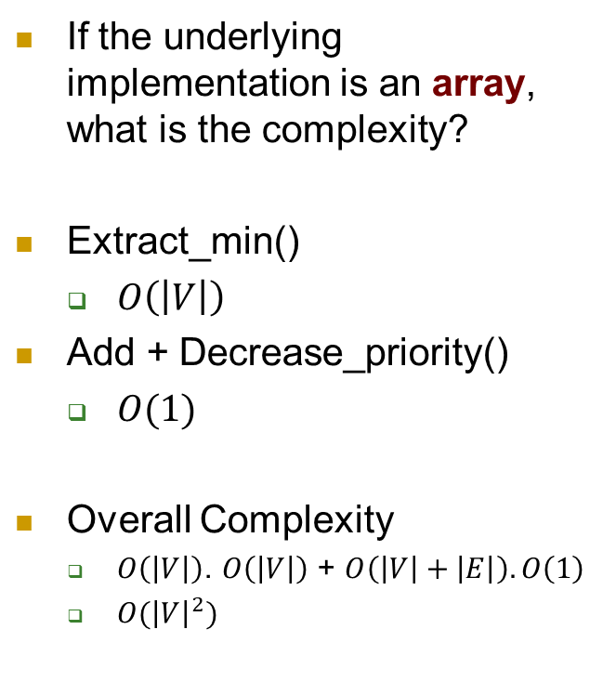
Dijkstra’s Algorithm Complexity
If the underlying implementation is an array, what is the complexity?
Extract_min()
$O\left(\left|V\right|\right)$
Add + Decrease_priority()
$O(1)$
Overall Complexity
$O\left(\left|V\right|\right)$. $O\left(\left|V\right|\right)$ + $O\left(\left|V\right|+\left|E\right|\right).O\left(1\right)$
$O({\left|V\right|}^{2})$
Notes:
Pseudocode copied from https://en.wikipedia.org/wiki/Dijkstra%27s_algorithm

Slide 48
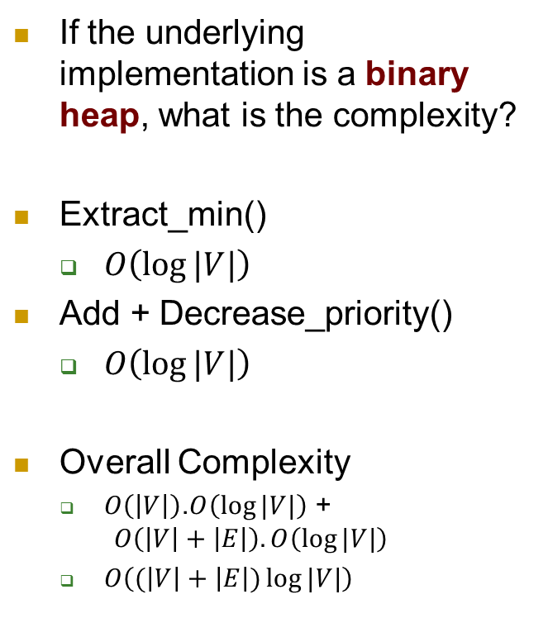
Dijkstra’s Algorithm Complexity
If the underlying implementation is a binary heap, what is the complexity?
Extract_min()
$O\left(\log{|V|}\right)$
Add + Decrease_priority()
$O\left(\log{|V|}\right)$
Overall Complexity
$O\left(\left|V\right|\right)$.$O\left(\log{|V|}\right)$ + $O\left(\left|V\right|+\left|E\right|\right).O\left(\log{|V|}\right)$
$O\left((\left|V\right|+\left|E\right|)\log{|V|}\right)$
Notes:
Pseudocode copied from https://en.wikipedia.org/wiki/Dijkstra%27s_algorithm

Slide 49
Drawbacks of Dijkstra’s Algorithm
It does not work for negative edges
Why would you need negative edges in real-world applications?
Cashflow
Heat released/absorbed during a chemical reaction
Benefit of reaching place X – cost of reaching place X

Slide 50
Finding shortest paths in the presence of negative edges
The Bellman-Ford algorithm is another algorithm to find shortest paths from a source node to all other nodes in a graph
It is slower than Dijsktra’s algorithm
But it is much more versatile than Dijsktra’s
It can find shortest paths in the presence of negative edges
It can also detect negative cycles

Slide 51
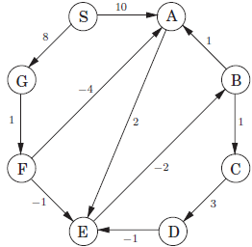
What is a negative cycle?
A cycle whose edges sum to a negative value that is reachable from the source
See the cycle A → E → B → A
Total weight adds up to a negative number
What happens if you keep on iterating over the cycle?
4
Notes:
Then you will keep on getting a lower number and hence there is no cheapest path, because every time you go over the cycle, you will find a cheaper path

Slide 52
What is a negative cycle?
A cycle whose edges sum to a negative value that is reachable from the source
Is there a negative cycle in this graph?
No

Slide 53
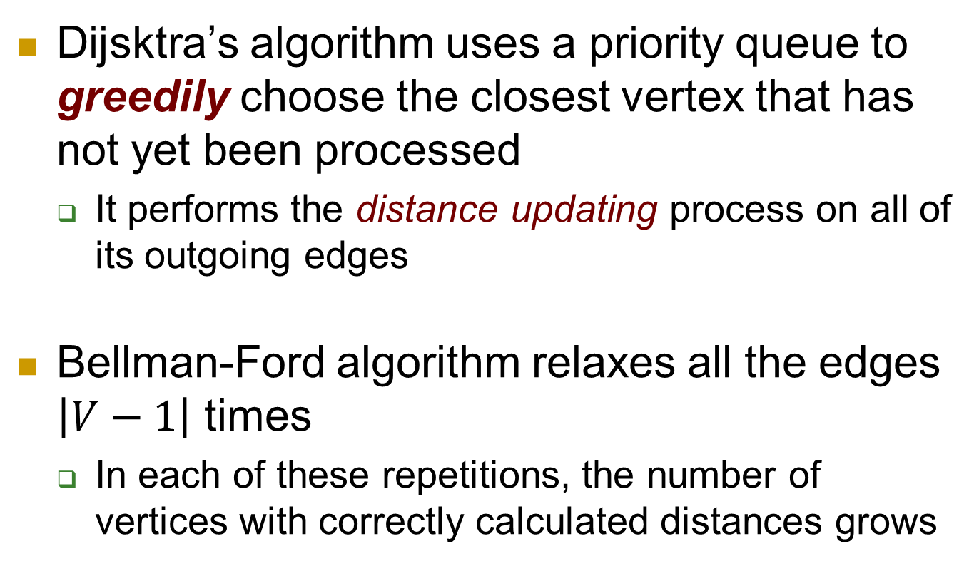
Bellman-Ford Algorithm
Dijsktra’s algorithm uses a priority queue to greedily choose the closest vertex that has not yet been processed
It performs the distance updating process on all of its outgoing edges
Bellman-Ford algorithm relaxes all the edges $\left|V−1\right|$ times
In each of these repetitions, the number of vertices with correctly calculated distances grows
Notes:
https://en.wikipedia.org/wiki/Bellman%E2%80%93Ford_algorithm

Slide 54
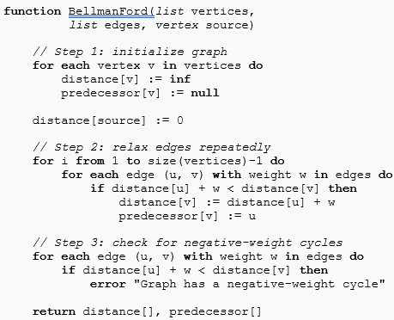
Bellman-Ford Algorithm
Notes:
The algorithm was first proposed by Alfonso Shimbel (1955), but is instead named after Richard Bellman and Lester Ford Jr., who published it in 1958 and 1956, respectively. Edward F. Moore also published the same algorithm in 1957, and for this reason it is also sometimes called the Bellman–Ford–Moore algorithm
https://en.wikipedia.org/wiki/Bellman%E2%80%93Ford_algorithm
// This implementation takes in a graph, represented as
// lists of vertices and edges, and fills two arrays
// (distance and predecessor) about the shortest path
// from the source to each vertex

Slide 55
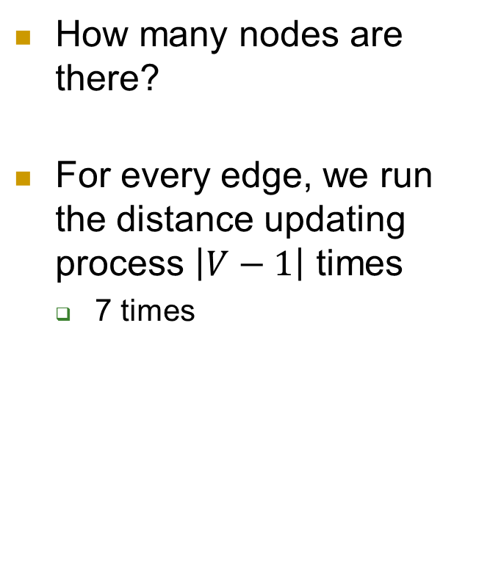
Bellman-Ford Algorithm
How many nodes are there?
For every edge, we run the distance updating process $\left|V−1\right|$ times
7 times

Slide 56

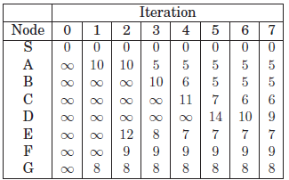
Bellman-Ford Algorithm

Slide 57
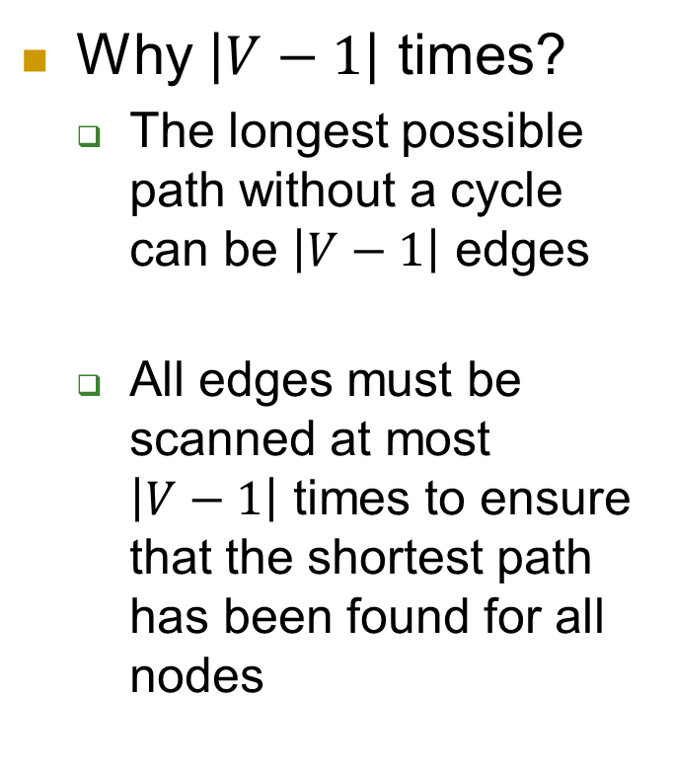
Bellman-Ford Algorithm
Why $\left|V−1\right|$ times?
The longest possible path without a cycle can be $\left|V−1\right|$ edges
All edges must be scanned at most $\left|V−1\right|$ times to ensure that the shortest path has been found for all nodes

Slide 58
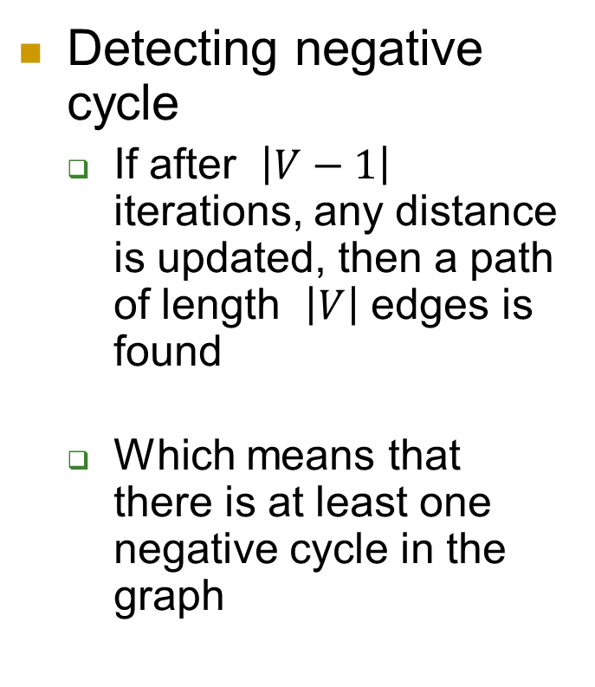
Bellman-Ford Algorithm
Detecting negative cycle
If after $\left|V−1\right|$ iterations, any distance is updated, then a path of length $\left|V\right|$ edges is found
Which means that there is at least one negative cycle in the graph

